Slide 1


Slide 2

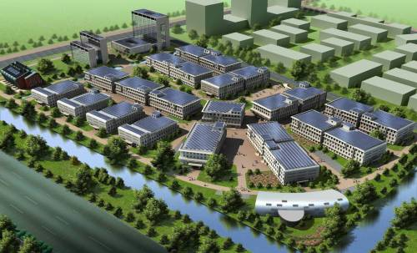
The Future of Power is Distributed
Technology improvements
  Solar, storage, communications, controls
Erases advantage of centralized plants

Slide 3
The 6 D’s of Our Energy Future
Distributed
Decentralized
Decarbonized
Diverse
Digitized
Democratized

Slide 4
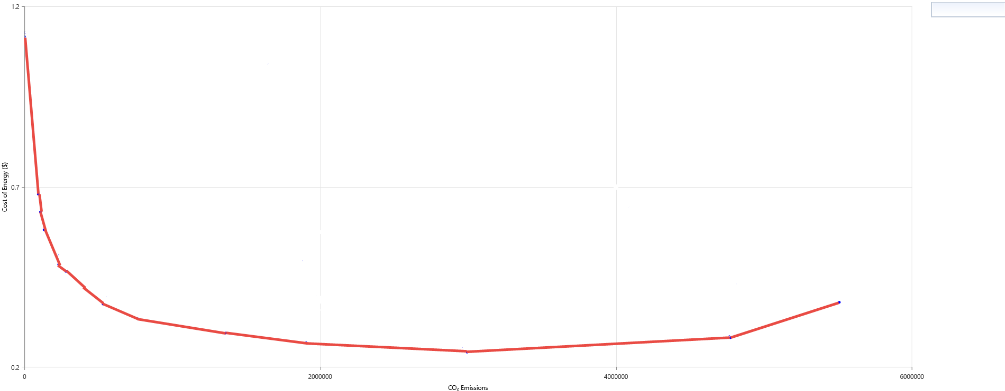
Getting to True Zero is Hard
$1.12/kWh
LCOE ($/kWh)
$0.38/kWh
No Renewables
$0.24/kWh
CO₂ Emissions (kg/yr.)
$2/watt PV, $300/kWh Lithium batteries (Total Installed Cost)

Slide 5
Getting to True Zero is Hard
$1.12/kWh
LCOE ($/kWh)
$0.38/kWh
No Renewables
$0.24/kWh
CO₂ Emissions (kg/yr.)
$2/watt PV, $300/kWh Lithium batteries (Total Installed Cost)

Slide 6
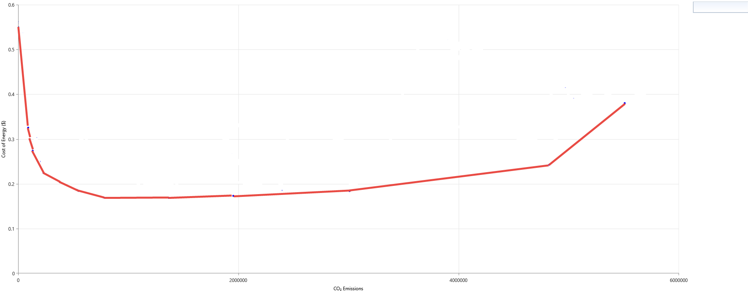
Getting to True Zero Will Continue to be Hard
$0.55/kWh
$0.38/kWh
No Renewables
LCOE ($/kWh)
$0.169/kWh
CO₂ Emissions (kg/yr.)
$1/watt PV, $100/kWh Lithium batteries (Total Installed Cost)

Slide 7
Why Is That Last 10% So Hard?
Requires large amounts of storage
  Some of which is only used very occasionally
Experience with smaller 100% renewable systems
  Aggressive load management
Where is the Smart Grid?

Slide 8

Clean Power Evolution
Smart, Clean Micro Grids
Smart Super Grid
Smaller Systems
Liquid fuels from oil
High renewable penetrations
Large Utilities
Security obstacles
Regulatory obstacles
Hybrid Renewable Power Systems
Island Power Systems
Major Utilities
Remote Diesels
Backup Diesels

Slide 9
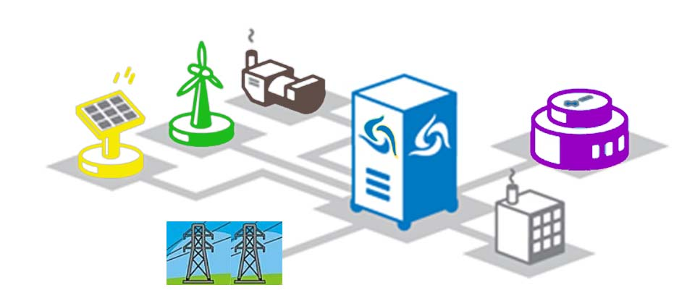
Today’s modern microgrid
A microgrid can be connected to a larger grid or operate independently.
Wind
Generator
Controls
Solar
Storage
Reasons for microgrids:
Improved resiliency
Economics
Clean energy mandate
Grid firming
Peak demand reduction
Electric Load
Grid

Slide 10


Microgrid Markets
Off-Grid
  Energy Access
    No existing infrastructure
  Island & isolated utilities
    Existing diesel-based power system
Grid-Connected (behind the meter)
  Reliability & resilience
  Utility cost management
    Demand charge, TOU, and sellback restrictions

Slide 11
Micro Grid Value Propositions
Reliability
Emergency Services & Critical Infrastructure
Military Bases
Forward Operating Bases
Backup for Unreliable Grids
Telecomm
Energy Access
Demand Mgmt.
RE & EV Integration
Campuses
Ecotourism
Energy Cost
Savings
Reduced
Emissions
Islands
Mines

Slide 12
Distributed Storage Has More Value
Value for Distributed Projects
  Reliability
  Utility rate management
    Demand charges
    TOU rates
    Sellback restrictions
  Voltage VAR stability
Value for Centralized Projects
  Increase transmission loading from large RE Projects
Location Agnostic
  Frequency regulation
  Duck Curve

Slide 13

Too Many Choices
Solar
Fuel Cells
Wind
Micro-turbines
Hydro
Geothermal
Micro-grids
Biomass
Demand Response
New Storage Techs.
Electric Vehicles
Load Management
Smart grids

Slide 14
What is best?
It depends on:
  Resources
  Loads
  Equipment prices
  Equipment performance
A confused mind says “No!”
HOMER fits the pieces together

Slide 15



How HOMER Works
Project Inputs
Analysis
Results
Sensitivity Analysis
Economic & Engineering
System Sizing
Performance Details
Financials
Various Reports
Load Profile
Site-Specific Resources
System Components
Optimization
Simulation

Slide 16
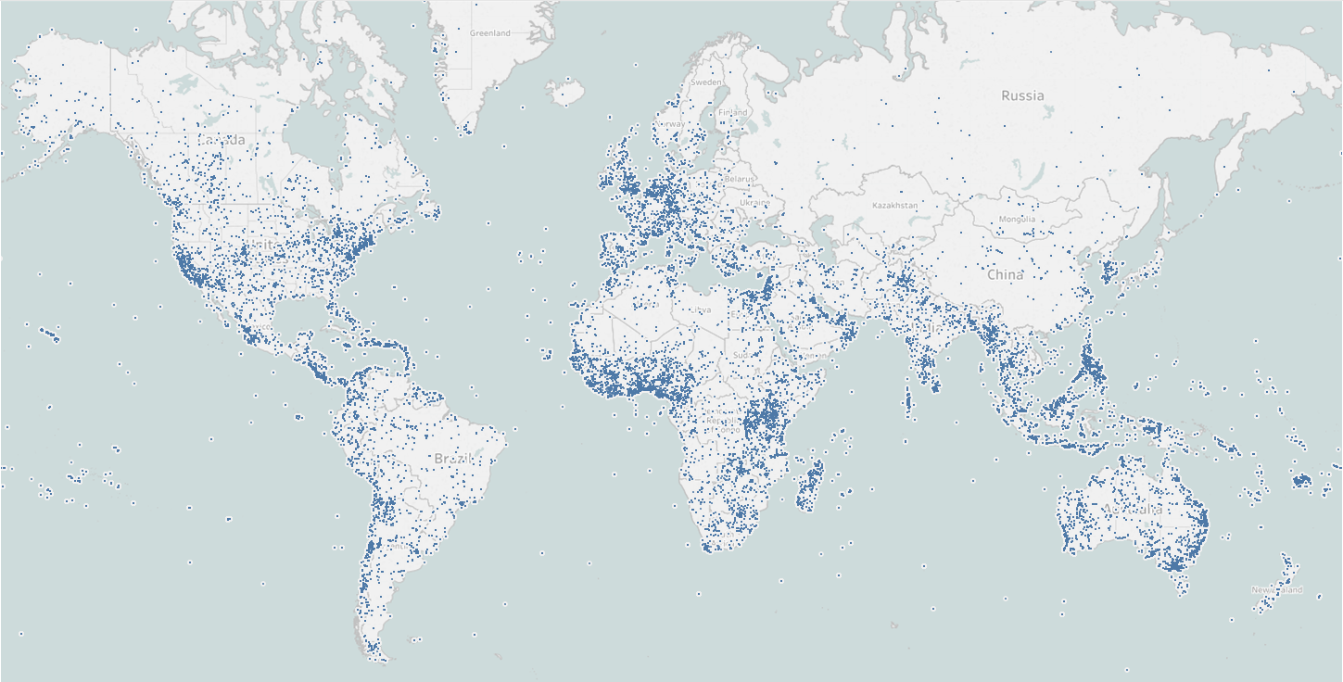
HOMER Energy
Designing Hybrid Systems for over 25 years
1992 – 2008 at NREL
2009: HOMER Energy created with exclusive license
>250,000 people have used HOMER
>100,000 opted-in to our network
Global Data
3 million HOMER files
70,000 projects modeled since 2014

Slide 17



































































HOMER Users…
Developers
Component
Suppliers
Education
Engineering
Firms
Government &
Financial
Institutions
Utilities

Slide 18
HOMER Connects the Micro Grid World
Renewable Advocates
HOMER Model
Power
Engineers
Financiers
Utility Operators
Software as a communication tool

Slide 19



Try HOMER for Free
http://quickstart.homerenergy.com/
Free to use SaaS based – Nothing to download
https://www.homerenergy.com/products/grid/index.html
HOMER’s demand charge reduction tool with utility rate database
(United States, Canada and Mexico)
Grid
https://www.homerenergy.com/homer-pro.html
HOMER’s “Flagship product” – Can model virtually any distributed energy generation or storage technology on or off the grid.

