Slide 1
"Rebellion to Tyrants is Obedience to God"
Great Seal Of The United States – original 1776 motto by Thomas Jefferson, Ben Franklin, and John Adams

Slide 2
The State of the Economy
Republican Study Committee
Denver, CO
January 25, 2016
by
Paul T. Prentice, Ph.D.
pprentice@coloradotech.edu

Slide 3
Austrian Monetary Theory
”The wavelike movement affecting the economic system, the recurrence of periods of boom which are followed by periods of depression, is the unavoidable outcome of the attempts, repeated again and again, to lower the gross market rate of interest by means of credit expansion. There is no means of avoiding the final collapse of a boom brought about by credit expansion. The alternative is only whether the crisis should come sooner as the result of a voluntary abandonment of further credit expansion, or later as a final and total catastrophe of the currency system involved.”
-- Ludwig von Mises (Human Action, 1949)

Slide 4
Government Manipulation of Money, Credit, and Interest Leads to “Malinvestment”
An economy needs real market prices in order to allocate scarce resources to their optimal use.
Market prices emerge spontaneously from the subjective values of buyers and sellers engaged in voluntary exchange.
Quantitative Easing and Zero Interest Rate policy by the Federal Reserve have led to another unsustainable credit bubble.

Slide 5
State of the Economy
U.S. economy never fully recovered from the Great Recession.
Six and one-half years of growth in real GDP has averaged barely 2%.
Boom and bust credit cycle may now be entering a bust phase – without having a boom!

Slide 6
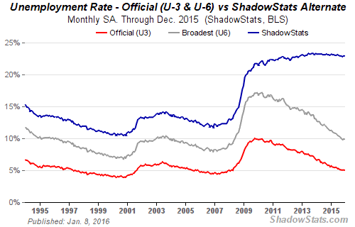
Actual Unemployment Over 20% www.shadowstats.com

Slide 7
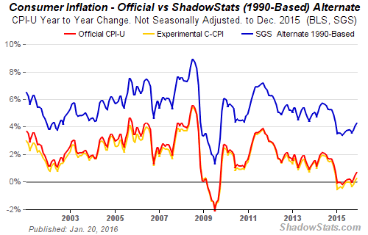
Actual Inflation Over 4% www.shadowstats.com

Slide 8
The Next Black Swan Is Out There Somewhere
Student loans?
State-and-local government bonds?
U.S. housing bubble?
China malinvestment?
Russia energy collapse?
U.S. energy collapse?

Slide 9
The Federal Reserve System:
Debt Disguised as Money
The Federal Reserve system does not create “money” in any real sense. It creates bank reserves out of thin air.
Actual currency is leveraged 10-1 into debt-disguised-as-money.
Your paycheck is not coming from a stock of real money.
It is coming from someone else's ability to pay their mortgage, car loan, student loan, or some other debt.

Slide 10
Here's how a fractional-reserve fiat-currency system works:
(1) The Fed “prints” $1000 of fiat reserves for a bank.
(2) The bank keeps $100 (10%) as “reserve” and loans out $900.
(3) That $900 of “debt disguised as money” is deposited in a bank.
(4) The bank keeps $90 (10%) and loans out $810.
(5) That $810 of “debt disguised as money” is deposited in a bank.
(6) The bank keeps $81 (10% and loans out $729 -- until the initial $1000 of fiat reserves becomes $10,000 of debt-disguised as money.

Slide 11
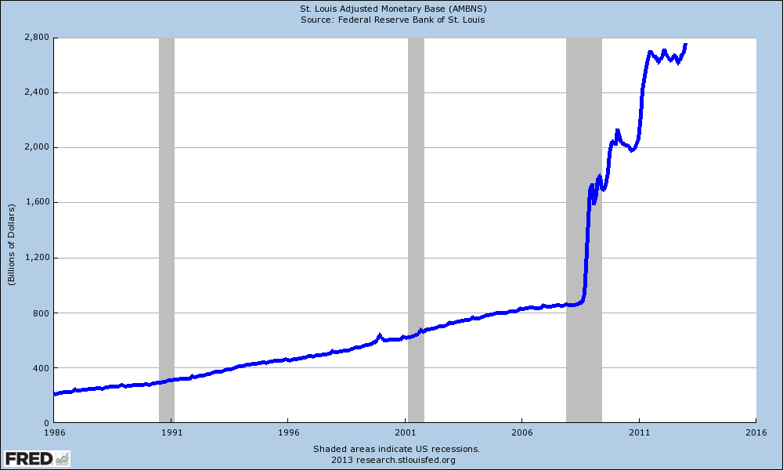
Monetary Base: More Than Tripled Since 2008

Slide 12
Monetary Base is Being Held as Bank Reserves
Not being fully-lent out (yet?).
Velocity of money has collapsed.
Masters of the Universe at the Fed do not have the control they think they do.
What will they do when the next inevitable recession hits? More QE? Return to ZIRP?
What can Colorado State Government do?
Strengthen the rainy-day fund – a storm is brewing.

