Slide 1

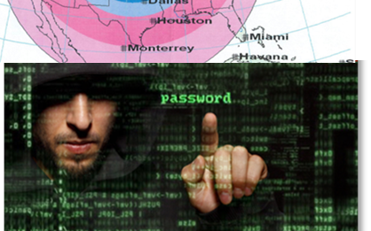

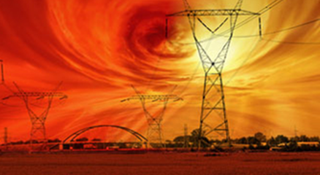

Task Force on National and Homeland Security
MICROGRIDS – A WATERSHED MOMENT
Much of this information was compiled by Dr. G. H. BAKER
NATIONAL SECURITY COUNCIL STAFF
Senior EMP Commission Staff
Senior Advisor EMP Task Force on National and Homeland Security

Slide 2
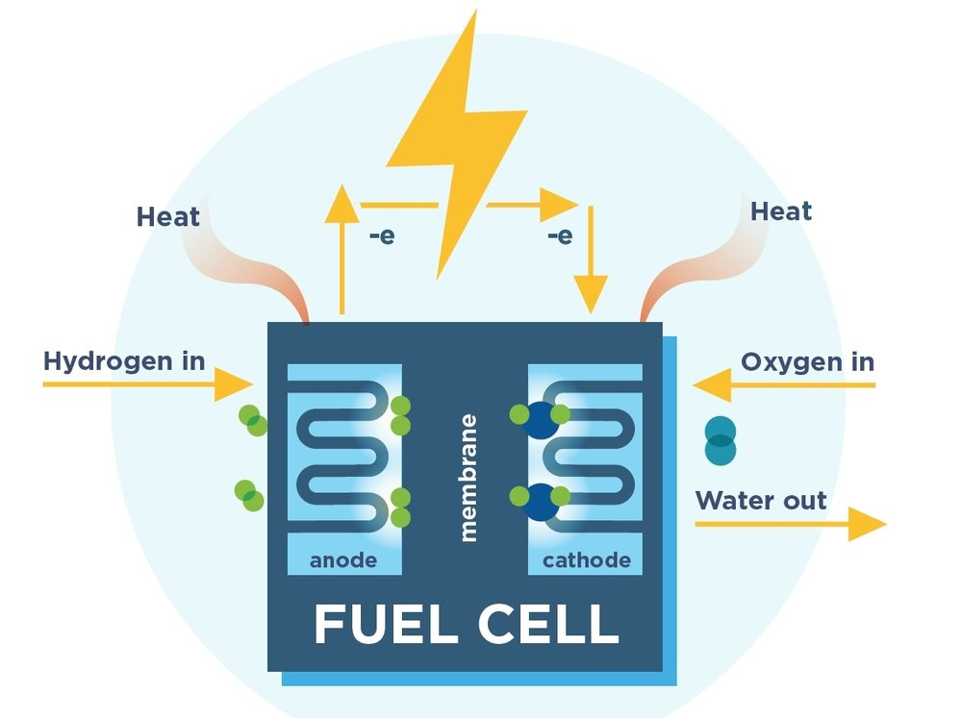
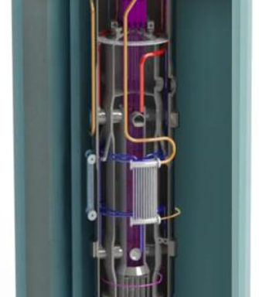
WARNING
We are at a “Watershed Moment” in tech history
Incorporating Cyber/EMP protection in microgrid design and installations will greatly enhance grid survivability
Omitting Cyber/EMP protection will lead to grid resilience mayhem

Slide 3
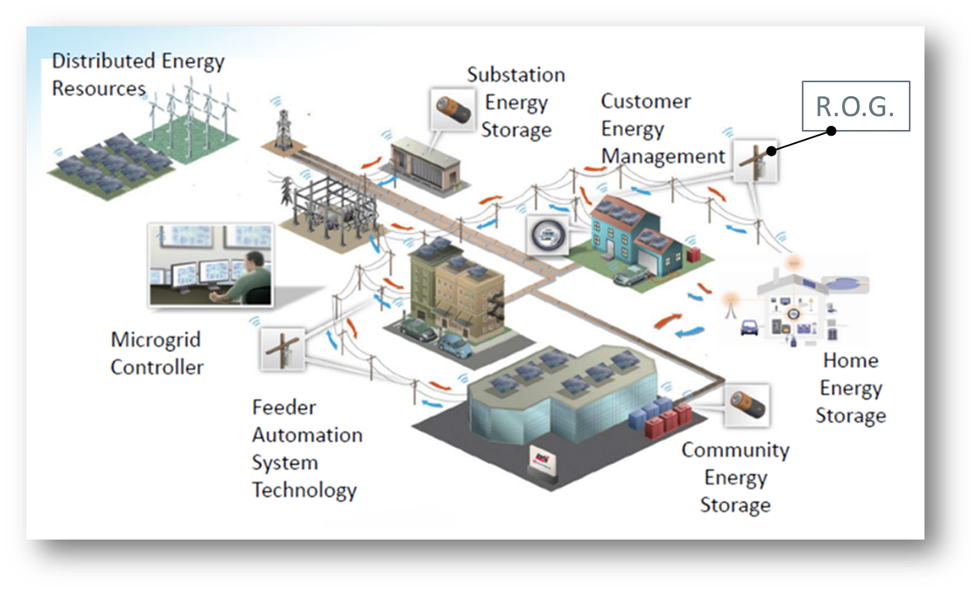
Microgrids have internal vulnerabilities Electronic sensing and control systems required to balance generation and load – susceptible to cyber and electromagnetic-caused debilitation Microgrids complicate the operation of the larger Macrogrid (rest of grid or ‘ROG’) Microgrids add additional layers of complexity to the electric grid – increasing the “vulnerability of complexity” Intermittent renewable energy sources can introduce rapid load swings to ROG Power back feed from microgrids can cause disruption and safety problems in ROG Physical/logical connectivity between microgrid and ROG increases EMP and cyber vulnerabilities If not designed with built-in protection, microgrids increase internal and ROG vulnerabilities to Cyber threats Electromagnetic threats including EMP, GMD, RF weapons
GROWING VULNERABILITY CONCERNS

Slide 4


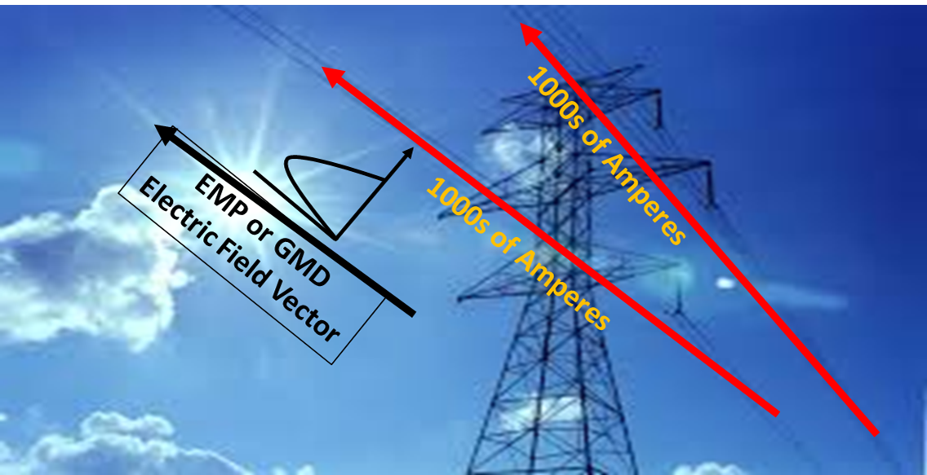
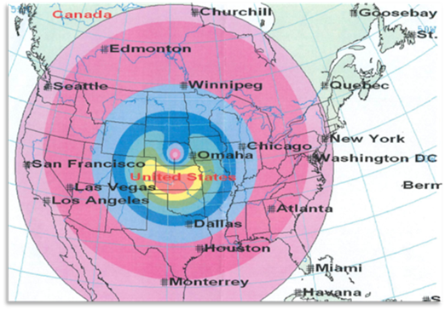
Physical Threats
A number of actors can shut down North American grid for months to years
FERC Chairman – attack on 9 substations is sufficient
Physical attack on Metcalf Substation nearly succeeded in depowering Silicon Valley
Cyber Threats
Unaddressed malware trojan implants could shut down large portions of grid on command
Aurora project demonstrated generator self-destruction triggered by remote cyber control of breakers
During 2015-2016 Russian hackers shut down large sector of Ukraine’s power grid.
In 2018, federal officials revealed Russians had penetrated the computers of multiple U.S. electric utilities gaining access privileges sufficient to cause power outages.
Electromagnetic events capable of continental-scale grid damage and long-term outages
Single event can shut down continental grid
10-12% annual probability of solar superstorm GMD
North Korea’s stated threat to use EMP against the U.S.
Nuclear EMP highest intensity currents/voltages, solar GMD a close second
Electric Power Grid is highest risk infrastructure due to long lines
NEW THREAT VECTORS ARE
HIGHLY ASYMMETRIC

Slide 5
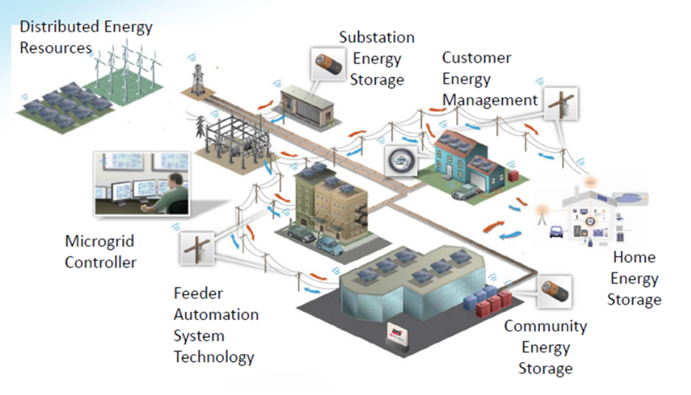
MICROGRID CONTROLS PROVIDE CYBER & EMP ATTACK VECTORS
MICROGRID CONTROL
NETWORK

Slide 6
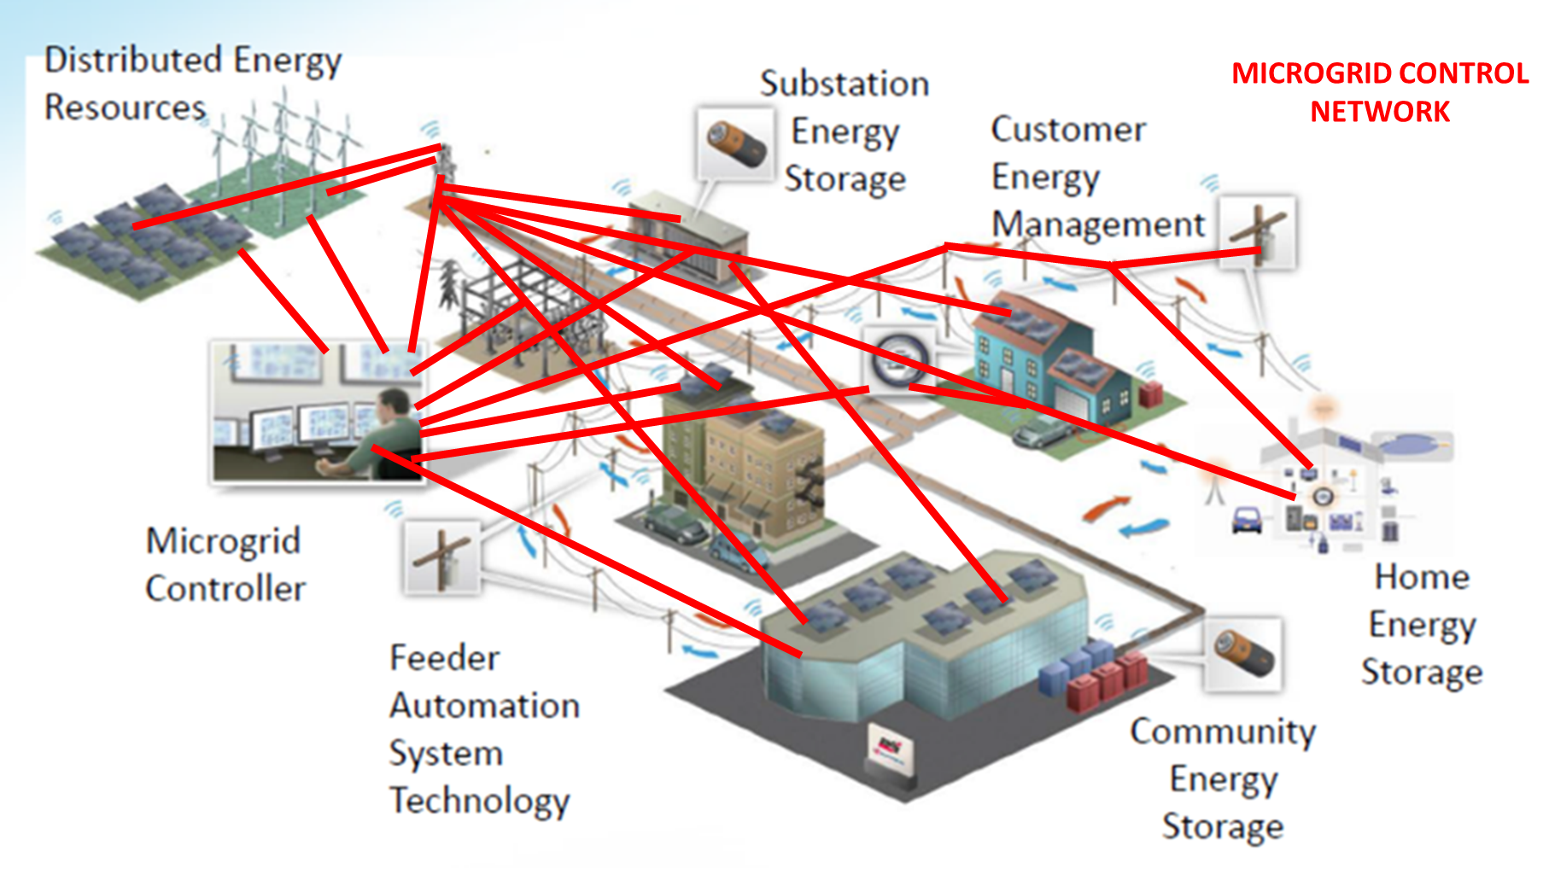
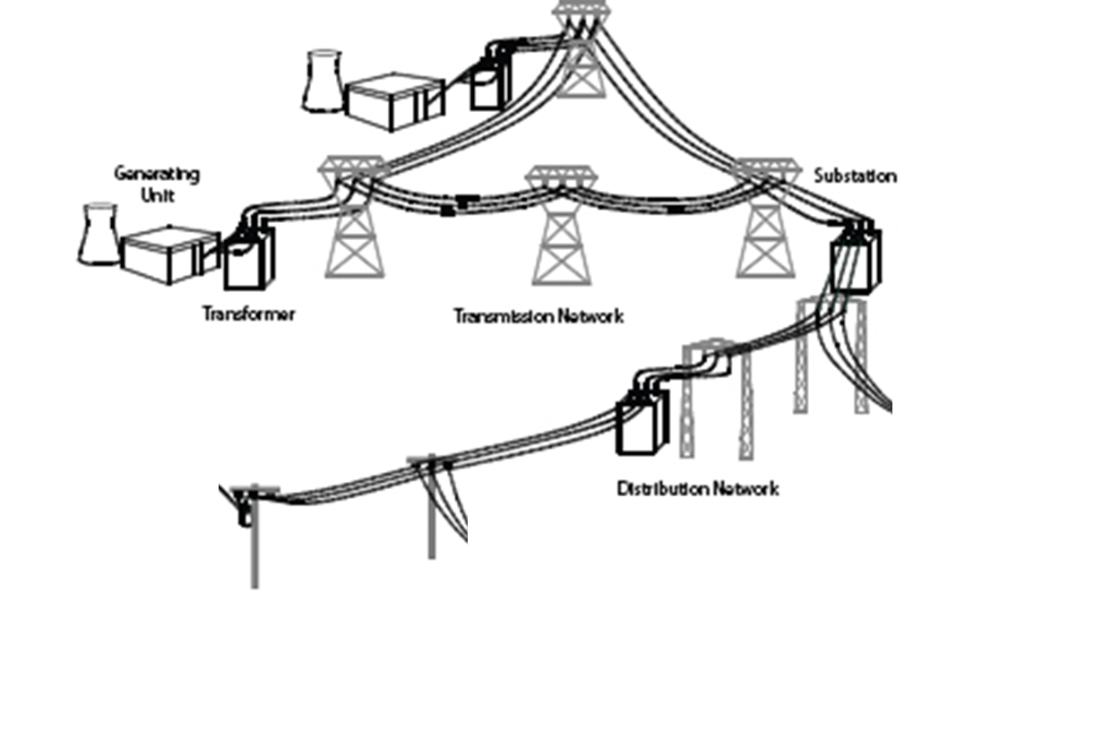
MICROGRIDS ALSO PROVIDE CYBER & EMP ATTACK VECTORS INTO LARGER GRID (R.O.G.)
BAD NEWS: ADDITION OF MICROGRIDS
CAN MAKE OUR COMPOSITE ELECTRIC POWER SYSTEM MORE VULNERABLE
Microgrid “Aggregation” = vulnerability Aggravation
CONTROL
NETWORK

Slide 7
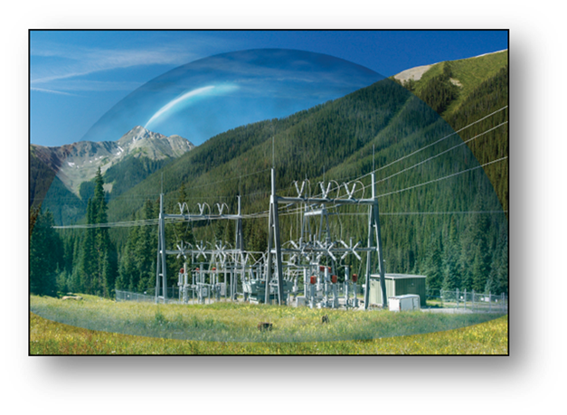
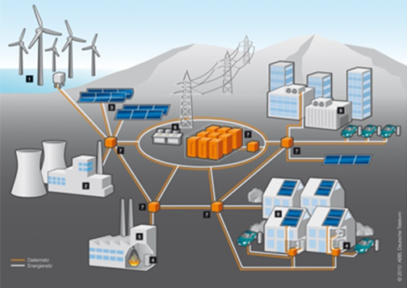
THE GOOD NEWS IS THAT WITH DESIGNED-IN PROTECTION, MICROGRIDS CAN BE MUCH MORE RESILIENT + ……

Slide 8
Air gaps/firewalls/software to isolate microgrid communication and control networks from the R.O.G. control systems and cloud. Small land area of microgrids and internal short line interconnects makes them virtually immune to GMD and late-time EMP (E3) threats True only for microgrid in island mode, isolated from ROG long-lines. Application of proven EMP design techniques insure microgrid survivability Shielding of critical electronic control systems/boxes Application of surge arrestors on conductive cable penetrations/terminals Use of optical fiber interconnections for all control signal lines.
HELP PROTECT R.O.G. MICROGRIDS ALSO PROVIDE CYBER & EMP ATTACK VECTORS INTO LARGER GRID (R.O.G.)

Slide 9
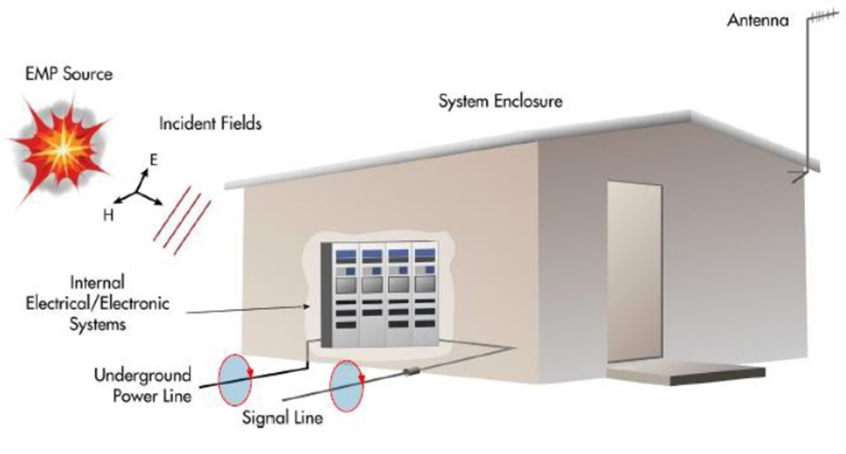

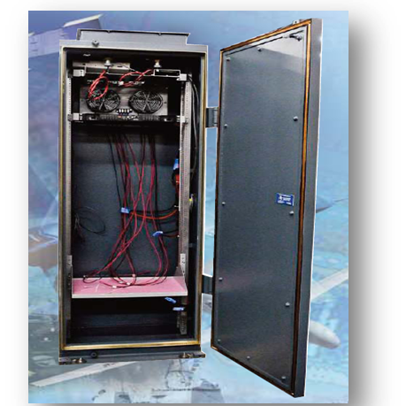
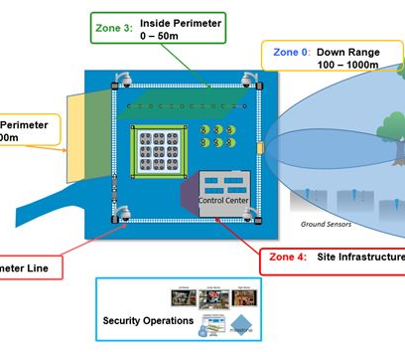
Composite Grid Protection
Two-pronged protection approach needed:
Global macrogrid (ROG) protection – longer term process involved – in the meantime…
Local protection of new microgrid installations to assure resilience of local critical infrastructure services
More Good News: We know how to harden – demonstrated protection standards/guidelines exist
EMP/GMD: IEC and Military Standards applicable
Cyber: Existing standards apply only to the bulk power system
For microgrids, best practices are known
Caution: Industrial Control System protection NOT the same as IT protection
Microgrids better able to avoid internet connections and establish air gaps than macrogrid if considered in microgrid design phase
Physical security benchmarks and standards available
ASD(HD&ASA) DCIP Standards and Benchmarks helpful, viz. AP-5 DCIP Electric Power Standards and Benchmarks
DoD-HDBK-2000.12 H

Slide 10
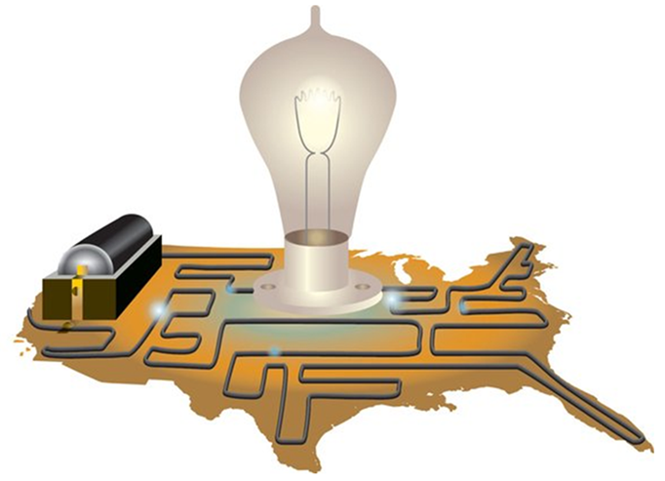

Installation of unprotected microgrids actually harms resilience of existing infrastructure – increases “vulnerability of complexity” Added layers of cyber/EMP vulnerability inherent in control systems, interconnecting pathways Includes failures due to Murphy's laws and Malefactor actions DoD experience with facility and weapon system hardening indicates designed-in protection costs are 10X lower than retrofit protection (2-5% vs. 20-50%) We are at a watershed where we must decide between: CARPE DIEM for designed-in protection on microgrid installations yielding much improved electricity supply resilience, or Proceed in lazy-faire manner to increase local and regional electric supply vulnerability
A PLEA FOR DESIGNED-IN EMP/CYBER/
PHYSICAL PROTECTION

Slide 11


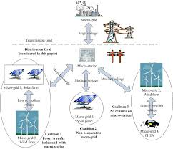
DESIGNED-IN MICROGRID PROTECTION
INCREASED OVERALL ELECTRIC
SUPPLY RESILIENCY
MICROGRID
IMPLEMENTATION
WATERSHED
UNPROTECTED MICROGRID INSTALLATIONS
DECREASED OVERALL ELECTRIC SUPPLY RESILIENCY
X
X
X
X
X
X
X
X
X
X
X
X

Slide 12
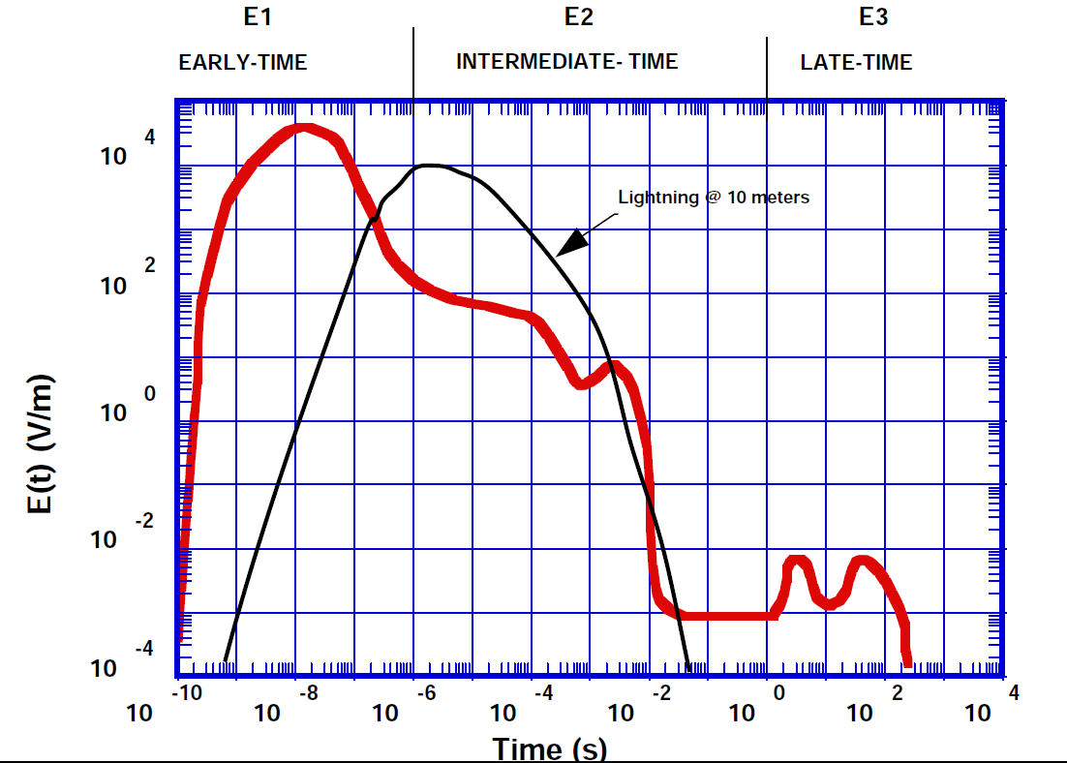
The HEMP Pulse

