Slide 1
Microgrid Summit
Michael Kadillak
Gallatin Energy Corporation
November 7, 2019

Slide 2

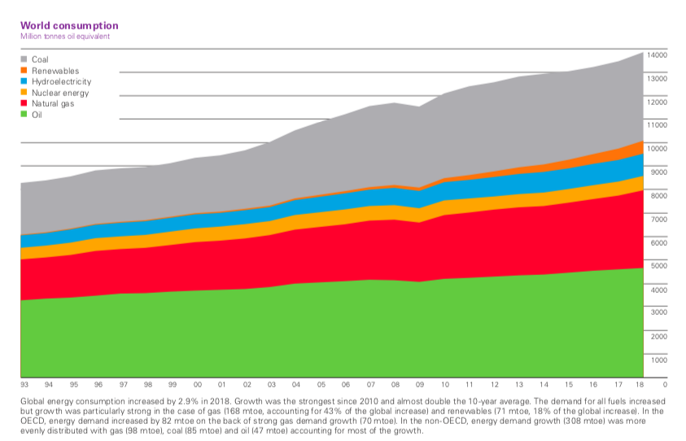
Global Energy Usage

Slide 3
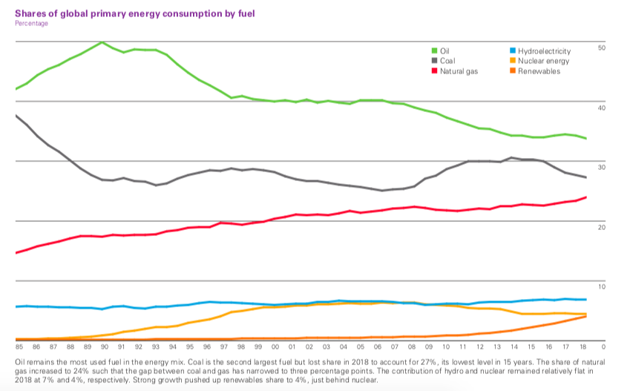
Shares of Global Energy Consumption By Fuel

Slide 4
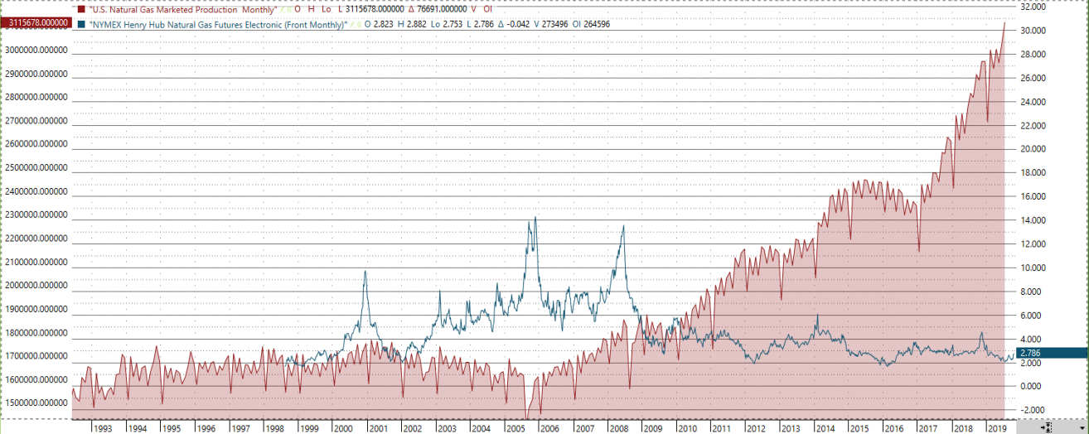
Marketed Natural Gas

Slide 5
Lay Of The Land
I believe in markets and their efficiency and I also believe in natural gas.
Technology advances drove the Shale Gas Revolution here in the US.
The US has 21.5% of the global gas supply and last year the incremental natural gas consumed was on par with the annual gas consumption in the UK.
The LNG export business is intensely competitive. Australian LNG exports rose from 2.1 BCF in 2011 to 11.4 BCF in 2019.
US LNG exporters are highly challenged to compete in this market potentially landlocking enormous quantities of natural gas in the Gulf Coast.
Most natural gas producers are deeply concerned about product disposition and net price received.

Slide 6
Business Advisement
Industrial manufacturing clients that consumes enormous quantities of power and natural gas.
Controllable costs as a function of net energy consumption can be 40%+ of final product costs.
Spending upwards of $1 mm + a month for power and $1.5 mm+ a month for natural gas.
Intense global competition driving forward business challenges.
Constantly on the prowl for costs saving projects / alternatives to evaluate and will consider any and all options that deliver the necessary results.

Slide 7
The Need To Compete
China produces 55% of the world’s aluminum. The US produces 1.48%
China produces 51% of the worlds steel. The US produces 4.8%
China and India are emerging economies and are responsible for a significant portion of current incremental global energy consumption.
For many large energy consuming manufacturing operations, the ability to effectively manage controllable energy costs (both net price and escalation) is critical to being able to remain in business.

Slide 8
Energy Costs Options
Bypass the natural gas utility and construct a pipeline directly to the natural gas supply source.
Negotiate special rates with power and natural gas utilities as a bypass threat to secure favorable price and contract terms
Self generate power at the manufacturing facility that assumes the all in costs of power generation facilities, fixed price of natural gas (or other fuels) and economics are favorable. Cogen when possible is optimal.
Excess power is sold in the wholesale market preferably under established terms so intrinsic risk is mitigated.
In the current market enormous consideration is being undertaken to evaluate self generation in parts of the US accessible to natural gas supply.

Slide 9
Wish List
FERC regulatory infrastructure rules remains intact.
The power markets completely deregulate.
Power consumers have the ability to select a power source at their discretion.
Market drivers facilitate the slow methodical and necessary efficiency improvements / augmentations to the power delivery infrastructure.

