Slide 1
"Rebellion to Tyrants is Obedience to God“
Great Seal Of The United States – original 1776 motto by Thomas Jefferson, Ben Franklin, and John Adams

Slide 2
Praxeology
The Challenge of Liberty:
2013 Summer Seminars for Students
Independent Institute
Colorado Springs, CO
June 18, 2013
Paul T. Prentice, Ph.D.
paul@PikesPeakEconomicsClub.com
www.PikesPeakEconomicsClub.com

Slide 3
Praxeology Defined
Praxeology (Gr. praxis (πρᾶξις), action; and logos (λόγος), reasoned discourse): The term was defined as "The science of human action" in 1890 by Alfred Espinas, Revue Philosophique.
The term was used previously, in 1882 by Louis Bourdeaux, the French author of a classification of the sciences, Théorie des sciences: Plan de Science intégrale; and as far back as 1608, by Clems Timpler, Philosophiae practicae systema methodicum.
Deductive argument based on “self-evident” or “axiomatic” truths.
Leads to universal laws of Human Action based on a-priori reasoning.

Slide 4
Ludwig von Mises:
Human Action
The most common use of the term “praxeology” is in connection with the work of Ludwig von Mises and the Austrian school of economics.
Praxeology: The scientific study of human action, which is purposeful behavior. A human acts whenever he uses means to achieve an end that he or she subjectively values.
Human action is thus intentional; a person acts for a reason.
Therefore not all human behavior is action in the praxeological sense: purely reflexive or unconscious bodily movements (such as coughing when exposed to tear gas) are not examples of action.

Slide 5
Ludwig von Mises:
(continued)
Praxeology starts from the undeniable axiom that human beings exist and act, from which we can logically deduce implications of this axiom.
These deduced propositions are true a priori; there is no need to test them in the way that a physicist might test a proposed "law" of Nature.
As long as a praxeological statement has been derived correctly, it must necessarily contain as much truth as the original axioms.
Its roots are found in Aristotelian logic and syllogisms.
Praxeology – Episode 1 (Youtube 00:04:07):
http://www.youtube.com/watch?v=MoNU_-__LlQ

Slide 6
Hans Herman-Hoppe:
Economic Science and the Austrian Method
Ch. 1 - Praxeology and Economic Science
“In order to emphasize the status of economics as a pure science, a science that has more in common with a discipline like applied logic than, for instance, with the empirical natural sciences, Mises proposes the term "praxeology" (the logic of action) for the branch of knowledge exemplified by economics.”
http://mises.org/esandtam/pes1.asp

Slide 7
“Government Charity” is an Oxymoron
A-Priori: Government has no pre-existing supply of resources.
Major Premise: Before government can give to one, it must first coerce from another (through taxes, inflation, or debt).
Definition: Charity - voluntary giving. (“Charity” is a form of “Love” in Greek. They both translate as “Agape”.)
Definition: Oxymoron – an internally inconsistent statement, such as “I am a Christian-Atheist”, or “I am a Libertarian-Socialist.”
Conclusion: Government charity is an oxymoron

Slide 8
“Rebellion to Tyrants is Obedience to God”
A-Priori I: Tyrants are opposed to liberty.
Major Premise I: Liberty is a creator-endowed natural right. “God who gave us life gave us liberty.” – Thomas Jefferson
Conclusion I: Tyrants are opposed to God’s natural rights.
Definition: Rebellion = Opposition.
Definition: Obedience = Opposition to Opposition.
A-Priori II: Opposition to opposition of something is to be for that thing.
(Not “Not-A” = A)
Conclusion II: “Rebellion to Tyrants is Obedience to God”.

Slide 9
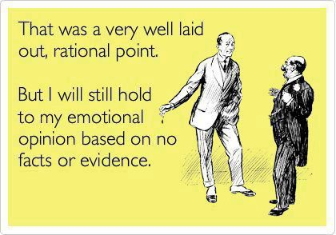
Reason v. Emotion

Slide 10
The End
Thank you for your attention.
We have time for a few questions.

