Slide 1
"Rebellion to Tyrants is Obedience to God"
Great Seal Of The United States – original 1776 motto by Thomas Jefferson, Ben Franklin, and John Adams

Slide 2
How the Federal Reserve Monetary System Destroys Liberty
“Free People, Free Markets (Part III)”
Pikes Peak Economics Club
The Vanguard School
Colorado Springs, CO
June 4, 2013
Paul T. Prentice, Ph.D.
paul@PikesPeakEconomicsClub.com
www.PikesPeakEconomicsClub.com

Slide 3
Capitalism is a moral system based on voluntary exchange. It must have sound money at its base in order to function.
"If you want to know when a society is set to vanish, watch the money. Whenever destroyers appear among men, they start by destroying money, for money is men’s protection and the base of moral existence. Destroyers seize gold and leave to its owner a counterfeit pile of papers.“ – Ayn Rand

Slide 4
Mayer Amschel Rothschild
“Give me control of a nation's money and I care not who makes her laws.”

Slide 5
The Constitution Authorizes Congress to “Coin Money”
(Article 1, Section 8)
“The Congress shall have Power … To coin Money, regulate the Value thereof, and of foreign Coin, and fix the Standard of Weights and Measures;”
“Coin Money” implies a precious metal based currency.
The Founders didn't have to specifically proscribe against a fiat currency. It was widely understood at the time that money in whatever form had to be backed by precious metal(s).

Slide 6
Article 1, Section 10
"No State shall … make any Thing but gold and silver Coin a Tender in Payment of Debts;” (emphasis mine)

Slide 7
Thomas Jefferson Warned Against Allowing Banks to Create Money
"The central bank is an institution of the most deadly hostility existing against the Principles and form of our Constitution. I am an Enemy to all banks discounting bills or notes for anything but Coin."

Slide 8
Abraham Lincoln Warned Against A Debased Currency
“ ... no duty is more imperative on that Government, than the duty it owes the people, of furnishing them a sound and uniform currency.”

Slide 9
Ludwig von Mises Warned Against Fiat Currency
”The wavelike movement affecting the economic system, the recurrence of periods of boom which are followed by periods of depression, is the unavoidable outcome of the attempts, repeated again and again, to lower the gross market rate of interest by means of credit expansion. There is no means of avoiding the final collapse of a boom brought about by credit expansion. The alternative is only whether the crisis should come sooner as the result of a voluntary abandonment of further credit expansion, or later as a final and total catastrophe of the currency system involved.”

Slide 10
Yet that is just what we have with the Federal Reserve monetary system:
The Federal Reserve system is not “money” in any real sense. It is a system of credit and debt disguised as “money”.
Your paycheck is not coming from a stock of real money, it is coming from someone else's ability to pay their mortgage, car loan, or some other debt.

Slide 11
Here's how a fractional-reserve fiat-currency system works:
(1) The Fed “prints” $1000 of fiat reserves for a bank.
(2) The bank keeps $100 (10%) as “reserve” and loans out $900.
(3) That $900 of “debt disguised as money” is deposited in a bank.
(4) The bank keeps $90 (10%) and loans out $810.
(5) That $810 of “debt disguised as money” is deposited in a bank.
(6) The bank keeps $81 (10% and loans out $729 -- until the initial $1000 of fiat reserves becomes $10,000 of debt-disguised as money.

Slide 12
Centralized Money is Centralized Power
In his Communist Manifesto, published in 1848, Karl Marx proposed 10 measures to be implemented after the proletariat takes power, with the aim of centralizing all instruments of production in the hands of the state. Proposal Number Five was to bring about the “… centralization of credit in the banks of the state, by means of a national bank with state capital and an exclusive monopoly.”

Slide 13
Centralized Money is Centralized Power (cont’.)
"Lenin is said to have declared that the best way to destroy the Capitalistic System was to debauch the currency... Lenin was certainly right. There is no subtler, no surer means of overturning the existing basis of society than to debauch the currency. The process engages all the hidden forces of economic law on the side of destruction, and does it in a manner which not one man in a million can diagnose." -- John Maynard Keynes

Slide 14
Centralized Money is Centralized Power (cont’.)
"In the absence of the gold standard, there is no way to protect savings from confiscation through inflation. ... This is the shabby secret of the welfare statists' tirades against gold. Deficit spending is simply a scheme for the confiscation of wealth. Gold stands in the way of this insidious process. It stands as a protector of property rights. If one grasps this, one has no difficulty in understanding the statists' antagonism toward the gold standard." - Alan Greenspan

Slide 15
The Link Between a Degenerating Currency and a Degenerating Culture
Austrian Scholars Conference 2009
Ludwig von Mises Institute
Auburn, AL
March 14, 2009
Paul T. Prentice, Ph.D.
http://mises.org/media/3150/The-Link-Between-Degenerating-Currency-and-Degenerating-Culture

Slide 16
Axiom: Man Acts
Postulate: Human action involves moral choices. Man can act morally (voluntarily) or immorally (coercively).
In a natural state of liberty, government is by definition limited to securing man’s natural rights to life, liberty, and property.
Free societies choose moral voluntary behavior.
Immoral coercive behavior is by and large shunned.

Slide 17
"The Principle of spending money to be paid by posterity … is but swindling futurity on a large scale. – Thomas Jefferson
From America’s founding until WWI, total government commandeered 5-10% of the economy.
This means that 90-95% of human economic action was voluntary (moral).
There was little net accumulation of government debt. Deficits in one time period were by and large offset by surpluses in a later time period.

Slide 18
The moral basis of American society started to change in 1913
The 16th Amendment was the beginning of the end of formal property rights (the right to the fruit of one’s labor).
The simultaneous founding of the Federal Reserve System was the beginning of the end to another right – the right to a hard currency.
"Sound money was devised as an instrument for the protection of civil liberties against despotic inroads on the part of governments. Ideologically it belongs in the same class with political constitutions and bills of rights." - Ludwig von Mises

Slide 19
Theorem: A degenerating currency contributes to a degenerating society.

Slide 20
With a fractional-reserve fiat currency, government no longer needed to tax or borrow in order to spend. Now it could just print and spend.
The true tax rate is the percentage of resources commandeered by government.
Measured by calculating government spending as a percent of total spending.
Commandeering of resources could now be accomplished through the printing press. Even Keynes acknowledged this.

Slide 21
Within one generation of the creation of the Fed, the Great Depression ensued and the Welfare State became institutionalized -- the New Deal.
Constitutional restraints were gradually eroded.
No longer restrained by the necessity to tax before it can spend, government is set free to engage in unlimited “free lunch” promises.
These promises have misled a mal-educated body public into substituting the philosophy of individual responsibility with a philosophy of state “security”.

Slide 22
A cultural-political-economic death spiral begins
Society then demands more free lunches, leading to more fiat currency, etc.
The State crowds-out the moral behavior of the individual.

Slide 23
The State becomes both The Parent and The Spouse
Eventually, young women and men begin to have children without the means to support them.
Out-of-wedlock births skyrocket.
The family degenerates.

Slide 24
Behaviors are disconnected from consequences
The social safety net grows along with the government printing presses.
People are empowered to internalize benefits but externalize costs.
Moral hazard becomes the norm for society.
Maxam, Prentice, and Walker, “Does Government Regulation Crowd Out Private Responsibility?”, Austrian Scholars Conference, Ludwig von Mises Institute, March 2012

Slide 25
A nation birthed in liberty slowly transforms into a fascist state.
Generation after generation becomes increasingly corrupted.
Business is not immune, as can be seen in the current financial meltdown and bailout.
Fiat currency allows profit to be privatized while losses are socialized.

Slide 26
“The spread of collectivist ideas in the business world” – Murray Rothbard (America’s Great Depression, Ch. 10)
The “Swope Plan” to compulsively cartelize American business. (General Electric).
Endorsed by the U.S. Chamber of Commerce.
More and more businessmen become “political entrepreneurs” rather than “market entrepreneurs”. (Thomas DiLorenzo, How Capitalism Saved America)

Slide 27
Liberty is lost, since political liberty cannot be disconnected from economic liberty
“Power over a man’s subsistence is power over his will.” – Alexander Hamilton
"To be controlled in our economic pursuits means to be controlled in everything." – F.A. Hayek
“The ultimate sanction of a planned economy is the hangman.” – F.A. Hayek

Slide 28
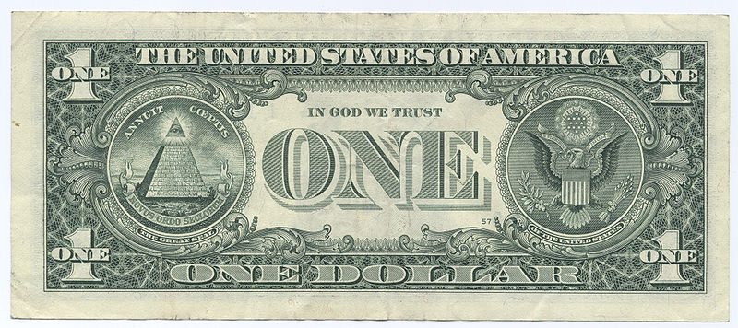
In God We Trust
Becomes: In Gov We Trust.
But when it comes to money, it should be:
In Gold We Trust.

Slide 29
Theorem: A degenerating currency contributes to a degenerating society.
QED
"Paper (money) is a mortgage on wealth that does not exist, backed by a gun aimed at those who are expected to produce it. Paper is a check drawn by legal looters upon an account that is not theirs: upon the virtue of the victims. Watch for the day when it bounces, marked, "Account Overdrawn." - Ayn Rand

Slide 30
Don’t take my word for it …
“The most important change which extensive government produces is a psychological change, an alteration in the character of the people.” – FA Hayek (“The Road to Serfdom”; Nobel Prize in Economics, 1974)
“A change that occurs when they willingly yield their freedom to a totalitarian state, even if it is the comfortable servitude of the welfare state.” – Benjamin Walker (“Ten Books Every Conservative Must Read”)
Socialism crushes the human spirit and the opportunity to develop one’s own responsibility, to direct one’s own human potential and to contribute to the commonwealth. – FA Hayek (paraphrase)

Slide 31
Are we still free?
"The American people will never knowingly adopt Socialism. But under the name of 'liberalism' they will adopt every fragment of the Socialist program, until one day America will be a Socialist nation, without knowing how it happened." -- Norman Thomas. Six-time U.S. Presidential candidate for the Socialist Party of America
Norman Thomas and Gus Hall, the U.S. Communist Party Candidate, both quit American politics, agreeing that the Republican and Democratic parties by 1970 had adopted every plank of the Socialist Party and they no longer had an alternate party platform on which to run.

Slide 32
Implications for the Economy:
How We Got Here
The recession was caused by too much easy money (i.e. too much debt).
Pushed along by political choices, not market choices.
The resulting misallocation of resources (Misean “malinvestment”) needed to be restructured.

Slide 33
Implications for the Economy:
Where We Are Going
A strong economy requires:
1) Sound currency (not).
2) Free trade (not).
3) Incentives to work, produce, save, and invest (not).
4) Deregulated markets (not).
5) Limited government (not).

Slide 34
More Economic Freedom Equals More Economic Wealth

Slide 35
Less Economic Freedom Equals Less Economic Wealth

Slide 36
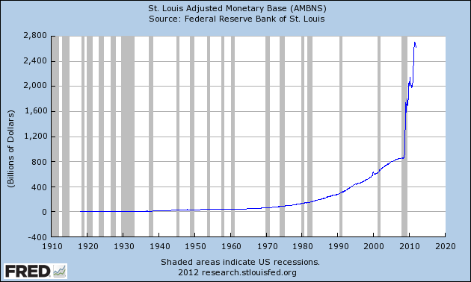
Monetary Base: More Than Tripled Since 2008

Slide 37
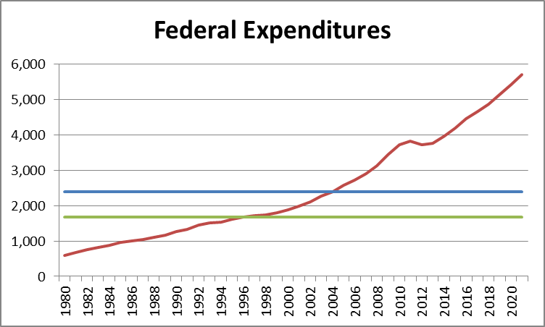
Federal Expenditures – “Capture the Baseline”

Slide 38
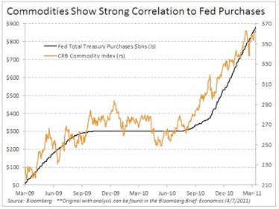
Ben Bernanke, “There is no relationship between monetary policy and prices.”

Slide 39
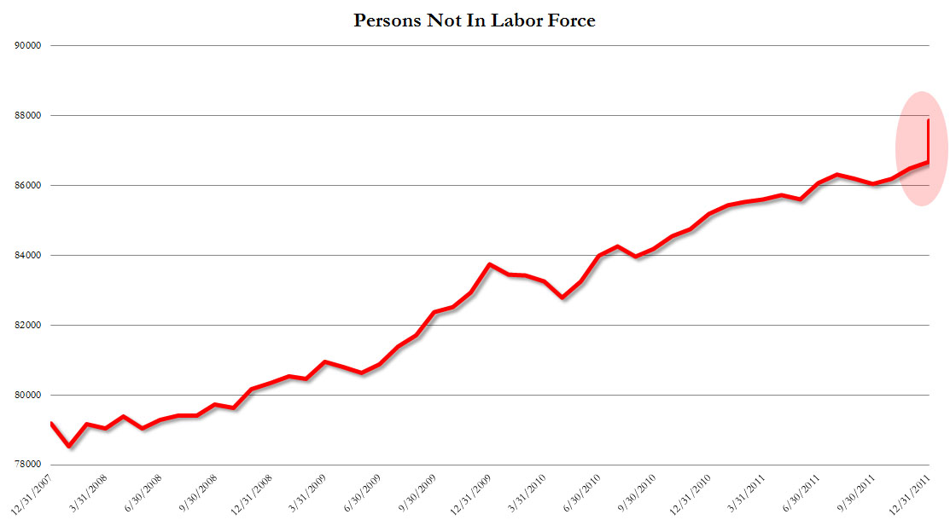
Unemployment Down as Millions of People Drop Out of the Labor Force

Slide 40
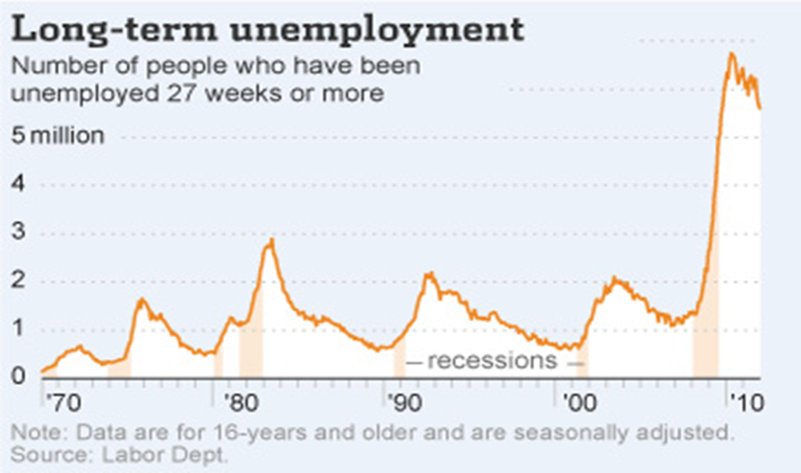
Record Number of Long-Term Unemployed

Slide 41
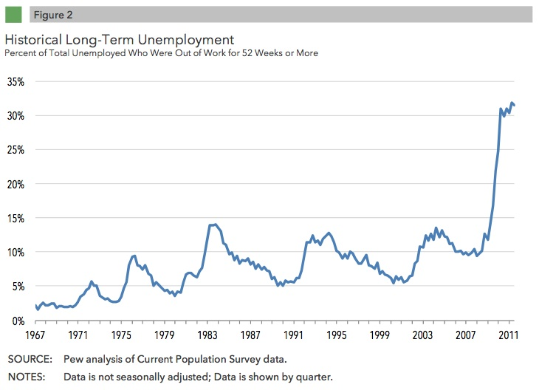
Record Percent of Long-Term Unemployed

Slide 42
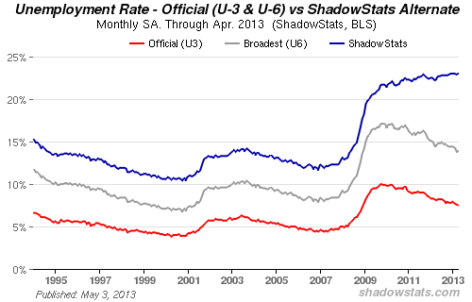
Real Unemployment Near 23% www.shadowstats.com

Slide 43
U.S. Debt Clock
http://www.usdebtclock.org/

Slide 44
The End
Thank you for your attention.
We have time for a few questions.

