Slide 1
"Rebellion to Tyrants is Obedience to God“
Great Seal Of The United States – original 1776 motto by Thomas Jefferson, Ben Franklin, and John Adams

Slide 2
The Moral Foundations of Capitalism
“Free People, Free Markets (Part I)”
Pikes Peak Economics Club
Colorado Springs, CO
November 5, 2014
Paul T. Prentice, Ph.D.
paul@PikesPeakEconomicsClub.com
www.PikesPeakEconomicsClub.com

Slide 3
Basic References
The content presented here represents the reading and study of hundreds of books, over the course of thousands of hours. I offer nothing original. These four books make a good start:
1) Michael Novak, On Two Wings: Humble Faith and Common Sense at America’s Founding.
2) W. Cleon Skousen, The Five-Thousand Year Leap.
3) F.A. Hayek, The Road to Serfdom.
4) Ayn Rand, Capitalism: The Unknown Ideal.

Slide 4
A Spiritual Perspective on Moral Economics
Jay W. Richards, Money, Greed, and God: Why Capitalism is the Solution and Not the Problem.
Charles Gave, “Jesus: The Unknown Economist”
“... we gave you this command: If any one will not work, let him not eat. For we hear that some of you are living in idleness, mere busybodies, not doing any work. Now we command and exhort in the Lord Jesus Christ to do their work in quietness and earn their own living.”, 2 Thes. 3:10-12

Slide 5
Capitalism is the Economic Dimension of Liberty
Economics: The use of scarce resources, that have alternative uses, to achieve goals.
Liberty: Freedom tempered by responsibility to a moral code.

Slide 6
Capitalism is a Philosophy
(must have three distinct components)
Philosophy
(love of truth
or knowledge)
Ethics
(moral code)
Metaphysics
(nature of reality)
Epistemology
(method for
discovering truth)

Slide 7
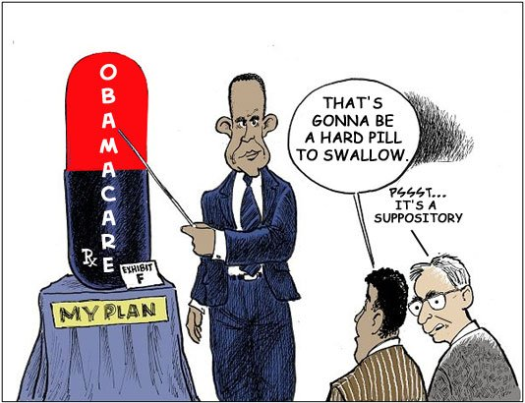

Slide 8
Capitalist Ethics
"Every man, as long as he does not violate the laws of justice, is left perfectly free to pursue his own interest his own way, and to bring both his industry and capital into competition with those of any other man or order of men." - Adam Smith (1776)
"The only freedom deserving the name, is that of pursuing our own good in our own way, so long as we do not attempt to deprive others of theirs, or impede their efforts to obtain it.” – John Stuart Mill (~1850)

Slide 9
Greco-Roman Legacy
"By Liberty I understand the Power which every Man has over his own Actions, and his Right to enjoy the Fruits of his Labour, Art, and Industry, as far as by it he hurts not the Society, or any Members of it.“ – Cato the Younger (~75 BC)

Slide 10
The Capitalist “Golden Rule”
Grounded in Judeo-Christian ethics, “You shall love your neighbor as yourself”. (Gal 5:14; Lev 19:18)
Golden Rule: “Do unto others as you would have them do unto you” (Luke 6:31; )
“Law of Liberty” (James 1:8, 13)
Ethics of Reciprocity found in 21 of 23 world philosophies. (Matt 7:12)

Slide 11
Contrast with Socialist Ethics
“From each according to his ability; to each according to his need.” - Karl Marx
"Society's needs come before the individual's needs." - Adolf Hitler

Slide 12
Capitalist Metaphysics
Reality is objective, not subjective.
There exists absolute truth.
Man’s nature is fixed, rooted in enlightened self-interest.

Slide 13
Socialist Metaphysics
Reality is subjective.
It is what the State says it is.
Stalin’s first census.
Hugo Chavez (GDP is capitalist plot).
Nicolas Sarkozy (equality indicators).
Man’s nature is malleable and perfectible through The State – can create “New Soviet Man” free of self-interest.

Slide 14
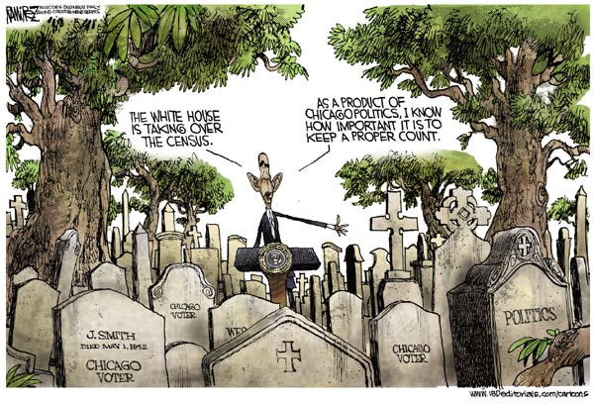
Modern Census: Chicago Style

Slide 15
Capitalist Epistemology
Faith-based rational mind.
Logic
Data
Science.

Slide 16
Socialist Epistemology
Reality is perceived not through logic, but through emotion.
Determined by feelings.
Ask a leftist what they think about something and they will inevitably reply, “I feel that …”

Slide 17
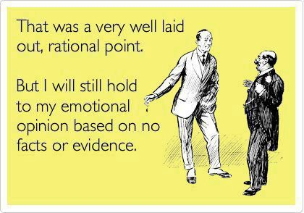
Reason v. Emotion

Slide 18
America’s Founders Intended a Free Market Economy
“I think all the world would gain by setting commerce at perfect liberty.” - Thomas Jefferson
“I own myself the friend to a very free system of commerce, and hold it as a truth, that commercial shackles are generally unjust, oppressive and impolitic …” - James Madison

Slide 19
Jefferson’s Declaration of Independence
“We hold these truths to be self-evident, that all men are created equal, that they are endowed by their Creator with certain unalienable Rights, that among these are Life, Liberty, and Property.” (early draft; based on John Locke’s writings 100 years earlier)

Slide 20
What is “Property”?
Our stuff (homes, cars, land, jewelry…).
Our financials (savings, stocks, bonds, …).
The fruits of our labors (income).
Intellectual property (ideas, hopes, dreams, …).
Property is our very humanity itself.
“Every man has a property in his own person.” – John Locke

Slide 21
Property Rights in the Colorado State Constitution
“That all persons have certain natural, essential and inalienable rights, among which may be reckoned the right of enjoying and defending their lives and liberties; that of acquiring, possessing, and protecting property; and of seeking and obtaining their safety and happiness” - Colorado State Constitution, Article II, Section 3 (author’s emphasis)

Slide 22
“I Produce, Therefore I Am”
“… in her natural right to eat the bread she earns with her own hands without taking leave of anyone else, she is my equal, and the equal of all others.” - Abraham Lincoln
"Property is surely a right of mankind as real as liberty … Property must be secured, or liberty cannot exist." - John Adams
Contrast to: “The theory of the Communists may be summed up in the single sentence: Abolition of private property.” – Karl Marx (The Communist Manifesto)

Slide 23
The Two Wings of Liberty:
Faith and Reason
About 3,000 years ago the threads of two distinct civilizations met, clashed and began to intertwine.
Classical Greco-Roman (law, logic, science).
Biblical Judeo-Christian (faith, ethics, morality)

Slide 24
“Liberty” and “Property”
“… proclaim liberty throughout the land to all its inhabitants; it shall be a jubilee for you, when each of you shall return to his property and each of you shall return to his family.” - Leviticus, 25:10
The phrase from Leviticus, “Proclaim liberty throughout the land.” is inscribed on America’s Liberty Bell.

Slide 25
The Individual
The idea that a created individual has free will is a distinctly Judeo-Christian concept.
The concept of individual liberty begins with free will in the Garden of Eden, where Adam and Eve were “free to choose”.
“No man is free who cannot command himself.” – Pythagoras (550 BC)
“Freedom is the right to live as we wish … God has entrusted me with myself.” – Epictetus, Roman slave and Greek Stoic philosopher (100 AD)

Slide 26
The Road to Western Civilization
The intersection of Law and Logic with Biblical Morality gradually led to a deeper concept of the sanctity of the created individual.
Aristotle (350 BC; logic, science).
Cicero (50 BC; natural law).
Judeo (Ten Commandments against coveting and stealing).
Jesus of Nazareth (0 BC; you are uniquely created).
St. Augustine (400 AD; individual had value, free will).
Justinian (550 AD; “Just Law” Codex Justinianus).
Magna Carta (1215 AD; Rights of Englishmen).
St. Thomas Aquinas (1250 AD; morality of profit).
John Locke’s “Life, Liberty, Property” (1650 AD; natural rights).
Thomas Jefferson’s “Declaration” (1776 AD; right to self-government).

Slide 27
God is the Source of Our Natural Rights
"A free people claim their rights as derived from the laws of nature, and not as the gift of their chief magistrate.“ - Thomas Jefferson
“You have rights antecedent to all earthly governments…rights derived from the Great Legislator of the universe.” – John Adams
“The sacred rights of mankind … are written, as with a sun beam, in the whole volume of human nature, by the hand of the Divinity itself.” – Alexander Hamilton
"The rights of man come not from the generosity of the state but from the hand of God.” - John F. Kennedy

Slide 28
Adam Smith
“Wealth of Nations” (1776)
Specialization, Production, and Trade
“It is a maxim of every prudent master of a family, never to attempt to make at home what it will cost him more to make than to buy…” – Adam Smith
Ben Franklin met with Adam Smith in England. There is anecdotal evidence that other founders did, as well.
“Wealth of Nations” was widely read by American Colonists.

Slide 29
Capitalism is based on voluntary (non-coerced) trade
“Man has almost constant occasion for the help of his brethren, and it is vain for him to expect it from their benevolence only. He will be more likely to prevail if he can interest their self-love in his favor, and show them that it is for their own advantage to do for him what he requires of them … It is not from the benevolence of the butcher, the brewer, or the baker that we expect our dinner, but from their regard to their own interest.” – Adam Smith

Slide 30
“Enlightened” Self-Interest
“Every individual … neither intends to promote the public interest, nor knows how much he is promoting it … He intends only his own gain, and he is in this, as in many other cases, led by an invisible hand to promote an end which was no part of his intention.” – Adam Smith

Slide 31
Capitalist Public Policy
“Take your hand out of my pocket and leave me alone.”
“Little else is requisite to carry a state to the highest degrees of opulence from the lowest barbarism, but peace, easy taxes, and tolerable administration of justice. … The natural effort of every individual to better his own condition, when suffered to exert itself with freedom and security is so powerful a principle that it is alone, and without any assistance … capable of carrying on the society to wealth and prosperity…” - Adam Smith

Slide 32
John Adams’ Ten Commandments Argument for Property Rights
“The moment the idea is admitted into society that property is not as sacred as the laws of God … anarchy and tyranny commence. If ‘Thou shalt not covet’ and ‘Thou shalt not steal’ were not commandments of Heaven, they must be made inviolable precepts in every society before it can be civilized or made free.” - John Adams

Slide 33
President Reagan
Connected to America’s Founding Principle: Limited Government
"Man is not free unless government is limited ... As government expands, liberty contracts." - Ronald Reagan
"Remember that every government service, every offer of government financed security, is paid for in the loss of personal freedom." - Ronald Reagan

Slide 34
Economic Liberty and Political Liberty Cannot be Separated
"In the general course of human nature, A power over a man's subsistence amounts to a power over his will.“ - Alexander Hamilton
"To be controlled in our economic pursuits means to be controlled in everything." – F.A. von Hayek
“To control the economy, you must control the people.” – Ronald Reagan

Slide 35
Where Goes America?
"The American people will never knowingly adopt Socialism. But under the name of 'liberalism' they will adopt every fragment of the Socialist program, until one day America will be a Socialist nation, without knowing how it happened." -- Norman Thomas (six-time U.S. Presidential candidate for the Socialist Party of America)
“We cannot expect the Americans to jump from Capitalism to Communism, but we can assist their elected leaders in giving Americans small doses of Socialism until they suddenly awake to find they have Communism.” - Nikita Khrushchev (1959)

Slide 36
Even Atheists Can Be Prophets
"When you see that trading is done, not by consent, but by compulsion - when you see that in order to produce, you need to obtain permission from men who produce nothing - when you see that money is flowing to those who deal, not in goods, but in favors - when you see that men get richer by graft and by pull than by work, and your laws don't protect you against them, but protect them against you - when you see corruption being rewarded and honesty becoming a self-sacrifice - you may know that your society is doomed." - Ayn Rand (1905-1982) Source: Atlas Shrugged, Francisco's "Money Speech"

Slide 37
“Nothing New Under the Sun”
(Ecc 1:19)
"The arrogance of officialdom should be tempered and controlled, and assistance to foreign lands should be curtailed, lest Rome fail." - Cicero (~50 BC)
"The real destroyer of the liberties of the people is he who spreads among them bounties, donations and benefits." – Plutarch (~75 AD)

Slide 38
Back to the Future?
“If ye love wealth greater than liberty, the tranquility of servitude greater than the animating contest for freedom … Crouch down and lick the hand that feeds you; and may posterity forget that ye were our countrymen.” – Samuel Adams
“Is life so dear, or peace so sweet, as to be purchased at the price of chains and slavery? Forbid it, Almighty God! I know not what course others may take; but as for me, give me liberty or give me death!” – Patrick Henry

Slide 39
Liberation Theology:
False Christianity
Holds that Socialism is the only biblical system of political economy.
“Jesus was the world’s first socialist, the first to seek a better life for mankind.” – Mikhail Gorbachev
"I swear by Christ — the greatest socialist in history." – Hugo Chavez
Liberation Theologist: – Rev. Jeremiah Wright (former spiritual advisor to President Obama)
“Absolutely. Redistribution of wealth is what the Bible is all about.” - Jim Wallis (current spiritual advisor to President Obama)

Slide 40
“Government charity” is an oxymoron
Government has no pre-existing supply of money. Before government can give to one, it must first take from another (taxes, inflation, or debt).
Biblical charity is based on voluntary giving. “Charity” is a form of “Love” in Greek. They both translate as “Agape”.
“Each one must do as he has made up his mind, not reluctantly or under compulsion, for God loves a cheerful giver.” – 2 Cor. 9:7

Slide 41
Final Thought
"The duel between Christianity and atheism is the most important in the world...(and) the struggle between individualism and collectivism is the same struggle reproduced on another level.“ - William F. Buckley, Jr. (God and Man at Yale, 1951)
"For we wrestle not against flesh and blood, but against principalities, against powers, against the rulers of the darkness of this world, against spiritual wickedness in high places." Ephesians 6:12

Slide 42
The End
Thank you for your attention.
We have time for a few questions.

